Slide 1


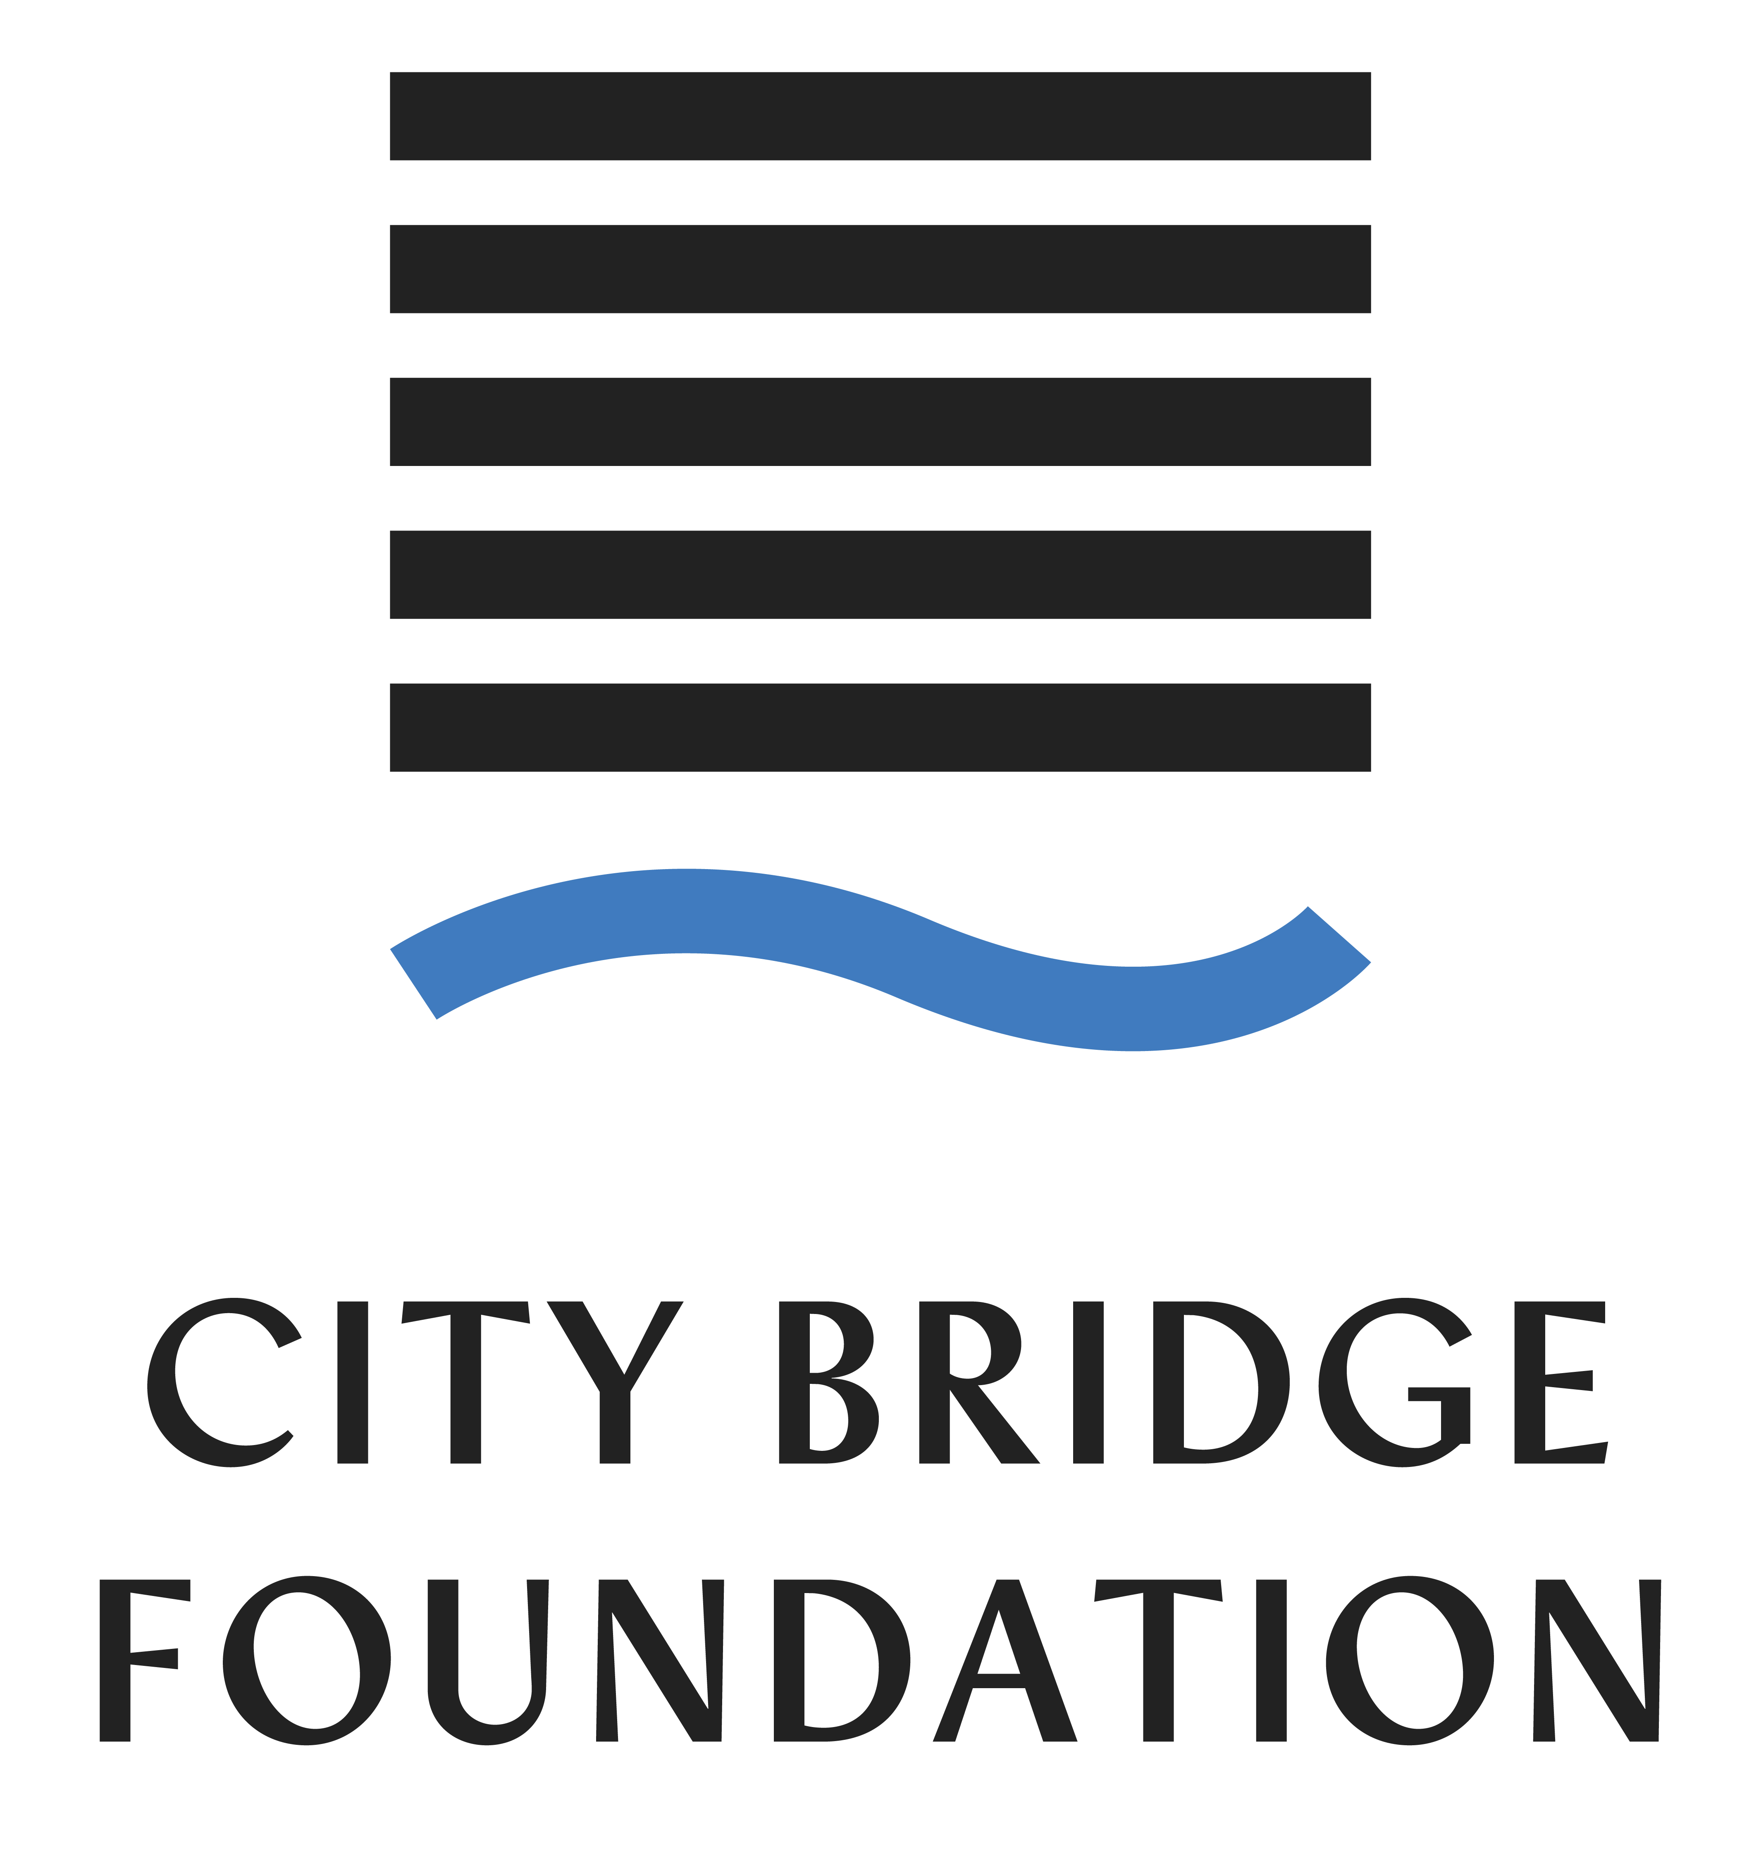
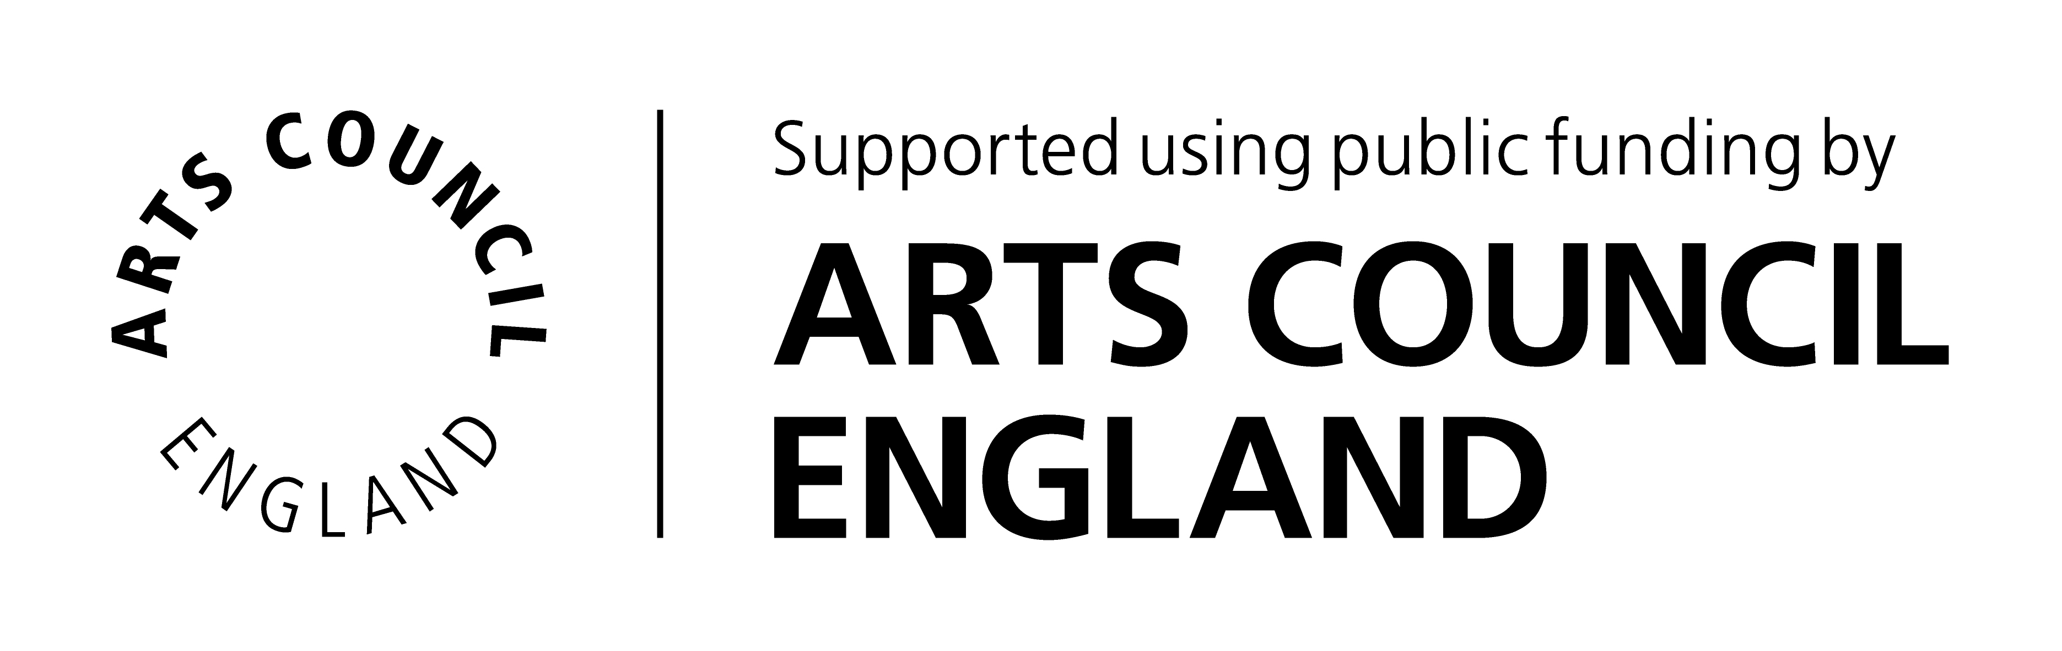
Exciting Opportunity!
Seed funding to get your Accessible Instrument Designs off the ground!
Easy Read
This is an Easy Read version of our Exciting Opportunity: Seed funding to get your Accessible Instrument Designs off the ground blog post
Supported by

Slide 2


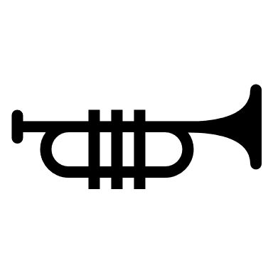
Introduction
Great news! We are accepting applications for a second time for seed funding grants.
A seed fund is the money raised to grow or begin developing an idea or project.​
These funding grants will support the development of new accessible musical instruments!

Slide 3





Access this Information in an Alternative Format:
The Information Pack is available in the following formats:
BSL
YouTube
Audio formats
SoundCloud
Easy Read
PDF
Large Print
Word document
Text Only
Word document

Slide 4
Access this Information in an Alternative Format:
The Expression of Interest form is available in the following formats:
BSL
YouTube
Audio formats
SoundCloud
Easy Read
PowerPoint
Large Print
Word document
Text Only
Word document
Microsoft form

Slide 5
Access this Information in an Alternative Format:
The Equal opportunities form is available in a Microsoft form format.
Microsoft form

Slide 6
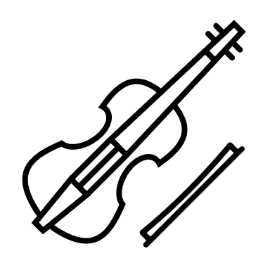



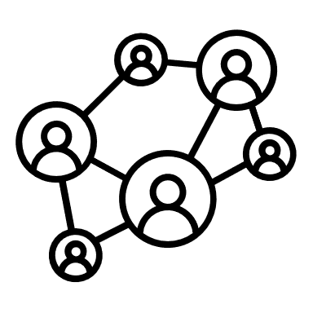
About the Seed Funding
DMLab champions creating accessible instruments, breaking down barriers for Disabled musicians.
We want to continue supporting instrument makers with ideas for new accessible devices.
We are offering two £1,000 grants to help create brand new accessible musical instruments.
This is your chance to bring your creative instrument ideas to life and show off your work at DMLab.
You can do this at future DMLab events.

Slide 7
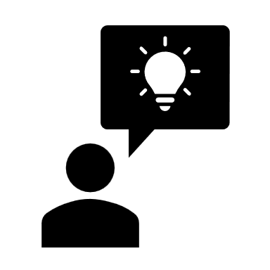


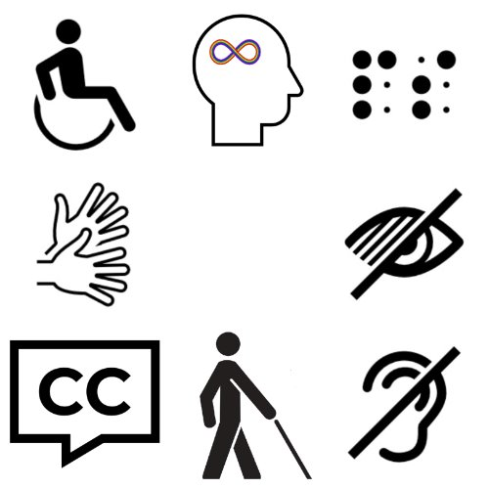
Who Can Apply?
All are welcome to apply! Whether you are a solo inventor or part of a team, we want to hear about your ideas.
We welcome ideas from musicians (Disabled or Non-Disabled), instrument makers and developers.
We are specifically seeking Expressions of Interest from those with creative ideas.
These ideas should focus on addressing specific access requirements for you and other people.

Slide 8



How to Apply
To register your interest, you need to complete the Expression of Interest form.
You also need to complete the Equal Opportunities Monitoring form.
You can also submit answers in audio or video format if that is more accessible for you.
The Expression of Interest form will give you the opportunity to introduce yourself.
You can also describe your proposed instrument, and outline the access needs it aims to fulfil.

Slide 9



How to Apply
In the form you can provide links to your previous work and upload any sketches or images of your idea.
The deadline for submitting your Expression of Interest is Sunday 1st September 2024.
If you have any questions about this opportunity or require support to make an application, please email Deborah Borg Brincat at info@drakemusic.org.
We welcome your applications. We are here to work with you to make music more inclusive and accessible for everyone.

Slide 10




What Happens Next?
Expression of Interest Deadline
Sunday 1st September 2024
We will let you know if you are shortlisted
Monday 16th September 2024
Meeting for shortlisted applicants
Monday 30th September or
Tuesday 1st October 2024
We will let you know if you have been selected
Monday 7th October 2024

Slide 11

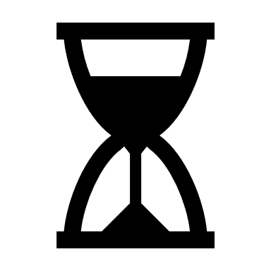
What Happens Next?
Once you have submitted your Expression of Interest we will reply as soon as we can to let you know that we have received it.
We appreciate that a lot of time and effort goes into submitting an Expression of Interest.

Slide 12

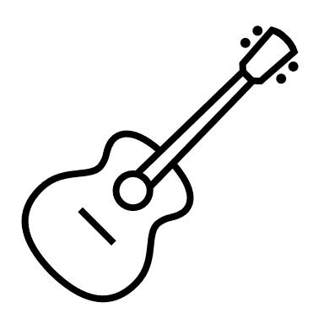

Looking for Inspiration?
Click on the links below:
Last year’s successful Grantees presenting their instruments at DMLab London.
News about instruments and projects we’ve been involved with.
Information about our accessible musical instrument collection.

Slide 13
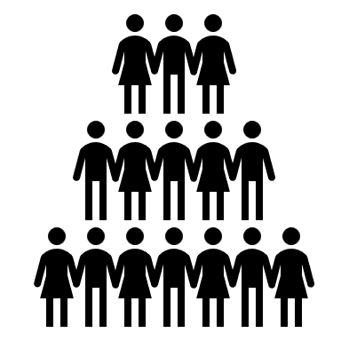

About DMLab
DMLab is a project for Disabled and Non-Disabled musicians, technologists and music makers.
The DMLab project allows these individuals to come together and explore accessible music making.
We hold regular meetups and events to help build more inclusive music making opportunities.
DMLab London is supported by two funders:
The City of London Corporation’s charitable funder, City Bridge Foundation.
Public funding from Arts Council England.
Click on this link to sign up to our mailing list and learn more about DMLab.

