Slide 1
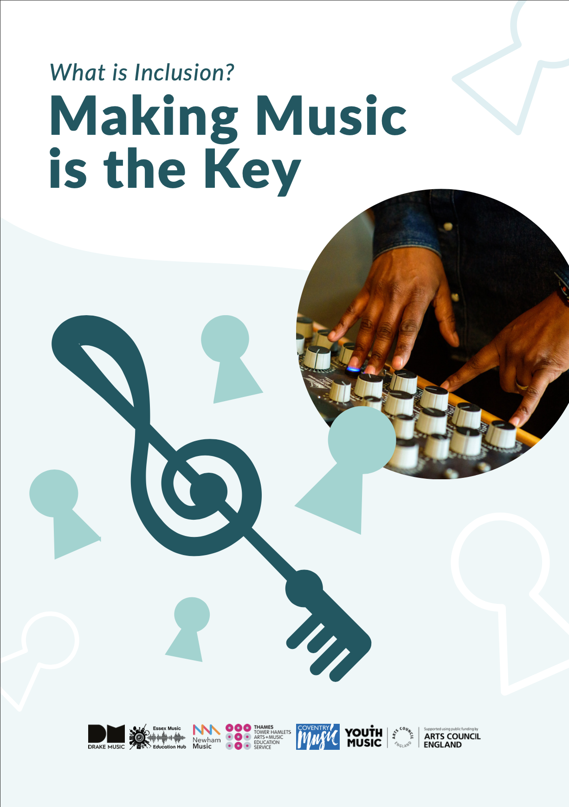

Slide 2





Document guidance
If you have a long document to read, it can be helpful to break it down into smaller pieces.
This will make it easier to focus and take in the information. Here are some tips.
Identify the different sections of the document. You can see the sections of this document on the Contents page.
Focus on reading one section at a time. Once you have finished reading a section, take a break.
Take notes as you read. This will help you to remember the key information and identify any questions you have.

Slide 3

Document guidance
Take breaks or pause. It's important to take breaks when reading a long document so that you do not get tired or lose focus.
The following words and phrases in this document are capitalised as they represent a movement or community:
Disabled People
Non- Disabled People
Disability Equality
Inclusion

Slide 4
Contents of the document
In this document you will find: | Introduction
Page number | Section
Page 5 | Introduction
Page 9 | Foreword – A short introduction from John Kelly
Page 14 | Process of Development
Page 16 | Being bold and radical
Page 22 | Four Principles of Inclusion
Page 29 | All means all
Page 35 | Where next?

Slide 5




Introduction
Think22 and an earlier project called Think2020 are important programmes of work funded by Youth Music.
These programmes of work helped to bring inclusive practice into music education in England.
The programmes focused on:
Advocacy, campaigning for inclusive practice and addressing underrepresentation of Disabled People.
Workforce development.
The delivery of inclusive music sessions in schools and other learning settings for children and young people.

Slide 6



This document is one of four resources. These four resources have been developed as part of the Think22 programme.
We have been working with four partners:
Essex Music Education Hub
Newham Music
THAMES ( Tower Hamlets Arts and Music Education Service)
Coventry Music
These resources are an example of Drake Music’s main approach where different people work together.
6

Slide 7



This includes:
Disabled and Non-Disabled educators
Musicians
Leaders
Artists
Practitioners
There is a need for more Disabled leaders, musicians and educators in music education.
Think22 and Think2020 understand that we are working in an environment where Disabled People are underrepresented.
Due to this underrepresentation, there needs to be action to bring about positive change.
7

Slide 8

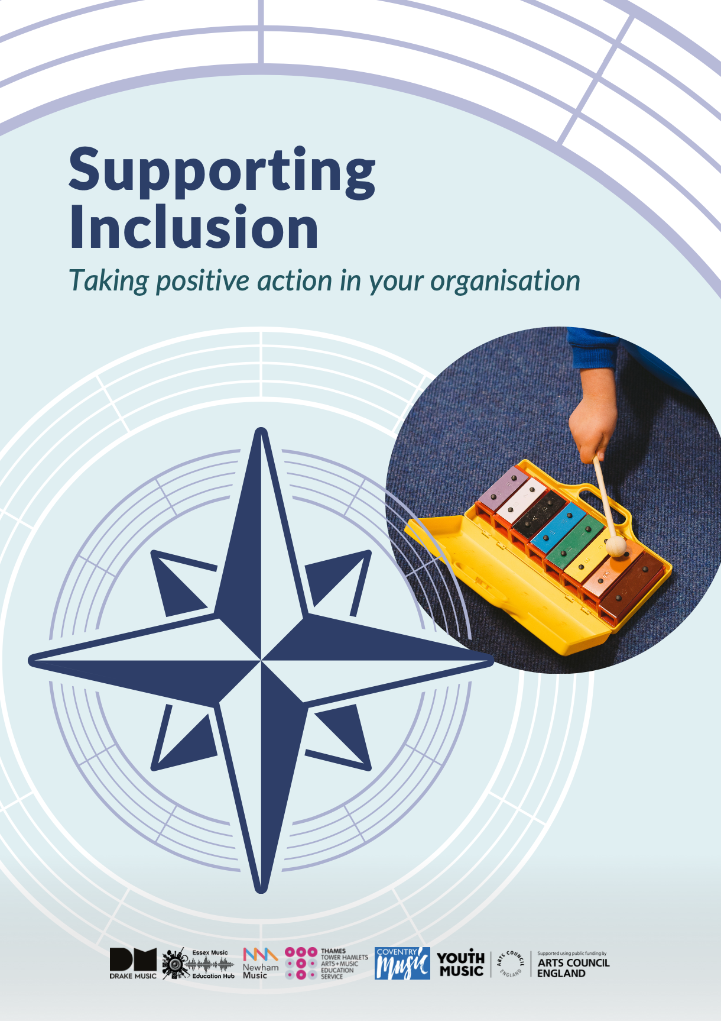
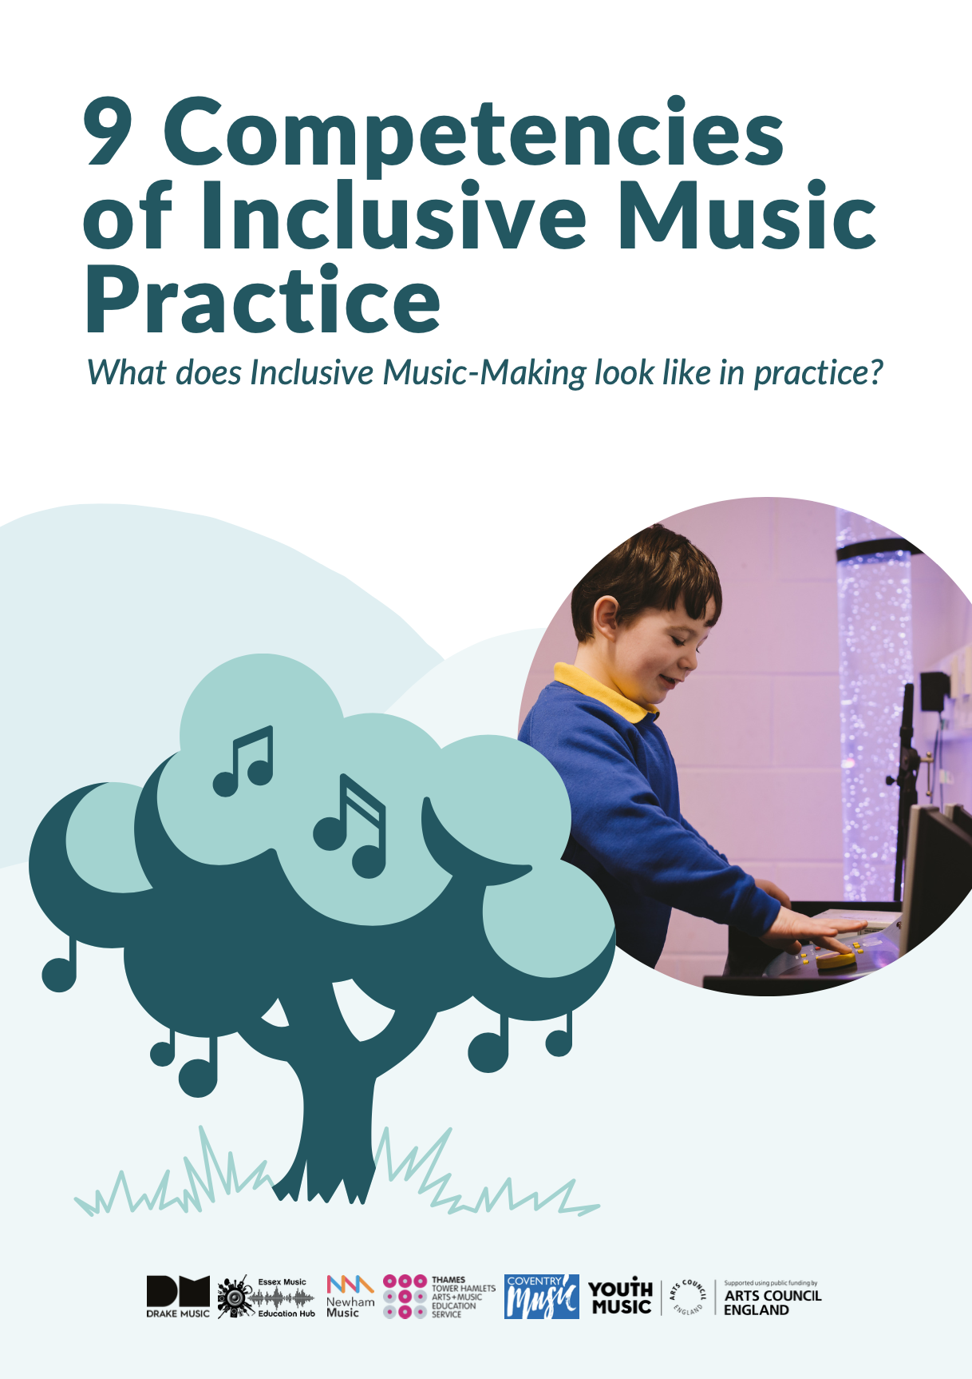
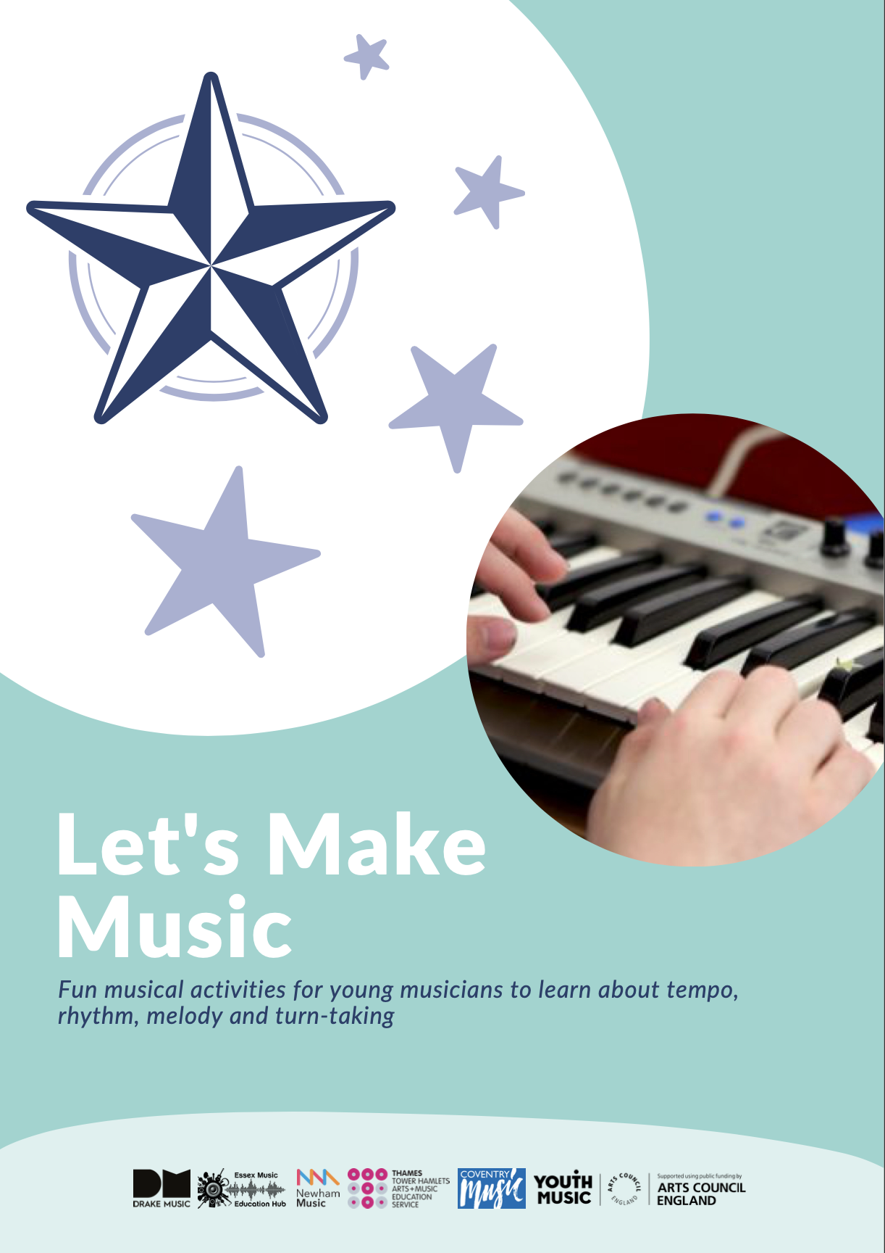
Think 22 resources to read:
What is Inclusion? Making Music is the Key ( this document).
Supporting Inclusion - Taking positive action in your organisation.
9 Competencies of Inclusive Music Practice - What does Inclusive Music-Making look like in Practice?
Let’s Make Music - Fun musical activities for young musicians to learn about tempo, rhythm, melody and turn- taking.
8

Slide 9



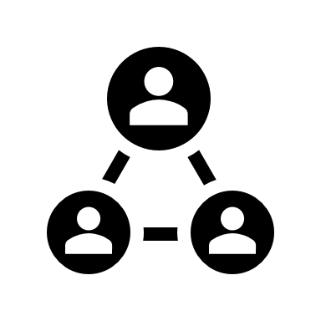
Foreword
Inclusion is important.
Inclusion means different things to different people and organisations.
We wanted to be clear as an organisation as to what Inclusion:
means to us
and how it shapes everything we do.
We are looking at Inclusion from a Disability Equality perspective.

Slide 10
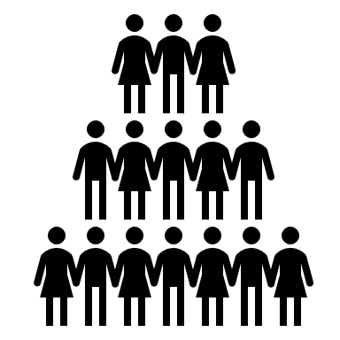

We take a rights-based approach to disability.
A rights-based approach to disability is a way of thinking about and addressing disability.
This approach is based on the rights of Disabled People.
We understand the importance of equality.
10

Slide 11
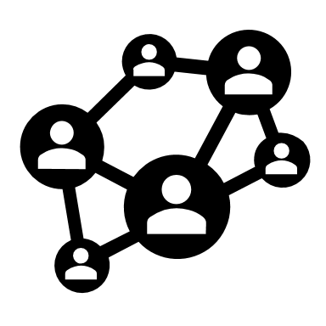


We also understand the role of the Social Model of Disability in:
How we work
Embed access
How it can transform our experiences as we work together
Inclusion is a journey where we learn to do things differently to make sure everyone is included.
Disabled People have been excluded from society for a long time.
11

Slide 12


This led to the recognition that Disabled People faced discrimination in all areas of their lives.
The response to this was the fight for equality and rights for Disabled People.
Disabled People changed the way we think about disability with the Social Model of Disability.
These changes now focus attention on the different barriers that exclude people.
12

Slide 13
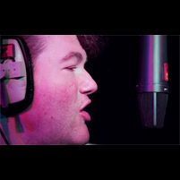
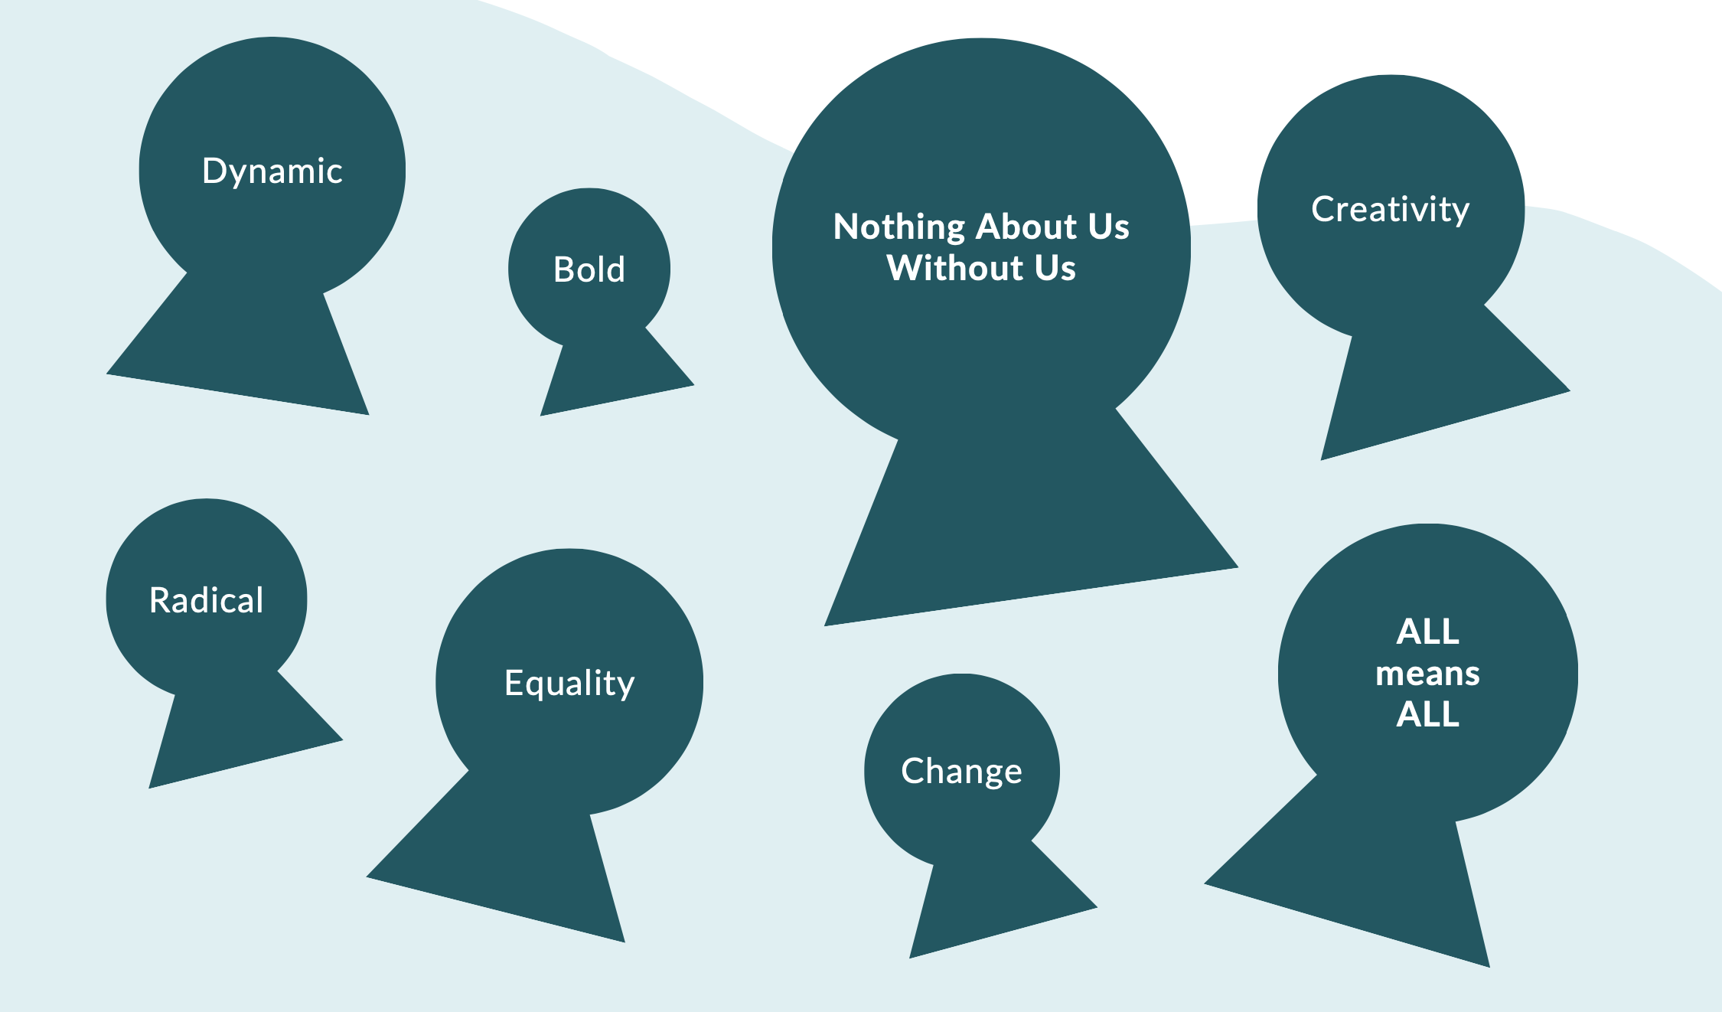
This document describes the values and beliefs that support Inclusion.
This will identify what Inclusion looks like.
This Foreword is by John Kelly, Musician and Drake Music Associate Musician
13

Slide 14


Process of Development
Purpose:
This paper was originally a discussion document for Drake Music.
Its purpose is to pull together our:
Current knowledge
Experience
Understanding
Practice of Inclusion
This is in the context of music education and Drake Music's work.
This paper will change over time.

Slide 15






We got here through:
Starting points
Bullet points
Messy words
Ideas
Messy thoughts
Moments of clear thinking
Pictures
Poems
Expressing important values and beliefs

Slide 16





We got here through:
Believing mistakes are fine when we learn from them
Music
Searching for change and opportunity
Believing anything we feel is missing needs to be said
Finding our own direction
Missing voices
Listening
Really listening
Action

Slide 17

We got here through:
Always trying to be free from confusing words and phrases
This is sometimes called Jargon.

Slide 18
The aims of this document are:
To look at key thoughts around Inclusion.
To agree on what Inclusion means for our work.
To share experiences and learn together. This is so that Inclusion can grow and become real in everything we do.
Context:
Drake Music has been music-making with Disabled and Non-Disabled People for a long time.
We believe everyone has the right to make music.
18

Slide 19

We believe that music technology can be a great tool in music-making.
Since 2015, Drake Music has been working to make music accessible to everyone, regardless of ability.
This is so that everyone can make music:
As equals
For fun and enjoyment
To learn
And can have a career in music if they want to

Slide 20


Being bold and radical
Making the changes we want means being bold and challenging things that have not changed.
For example:
Viewing disability through the Social Model of Disability.
We want to see more Disabled People in leadership positions.
Inclusion means giving Disabled People the freedom to choose their own pace, space and control.
This includes letting Disabled People lead and design things, and not assuming they will just "fit in" to existing ways of doing things.

Slide 21
Being bold and radical
Seeing access as everybody’s responsibility.
Celebrating our unique talents in music-making by always thinking and doing things in an Inclusive way.
Being mindful of power and listening to diverse perspectives.
Being valued so we all have an equal chance to thrive.
Knowing these things can make Inclusion happen.

Slide 22
Four Principles of Inclusion
Belonging
Understanding
Participating and Contributing
Value and Achieving

Slide 23




Four Principles of Inclusion
Belonging includes:
A feeling of being comfortable.
It feels right to be here.
Others have welcomed you with open arms.
You can be yourself.
Creativity

Slide 24


Four Principles of Inclusion
Understanding includes:
Verbal or non-verbal communication or experiences.
Signs that your needs and wishes are taken seriously.
You can say what you need to say.
You will be asked how you want things. This will be instead of assuming how you want things.
Our differences and our cultures are important to how we can come together and be ourselves.

Slide 25
Four Principles of Inclusion
Listening and learning from each other.
Thinking about what diversity and equality means in our work. Learning and practising are important.
We all need to be active in ensuring equality, participation and Inclusion.
Creativity is important because it helps us to think outside of the box.

Slide 26
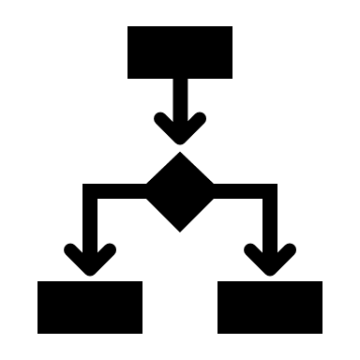


Four Principles of Inclusion
Participating and contributing includes:
Active choices and control.
Pace and space.
We can decide how we want to be involved in music and decision-making.
We have the space to find our own way to participate and contribute.
We can work at our own pace to meet our needs, contribute well and succeed. We can then achieve things together as equals.

Slide 27



Four Principles of Inclusion
Participating and contributing includes:
Being authentic.
Feeling real.
Having fun and enjoyment.
Doing things that celebrate and reflect our culture and passions.
Creativity

Slide 28




Four Principles of Inclusion
Value and achieving includes:
A recognition of what we have achieved.
Knowing yourself, growing, believing in yourself and feeling good about yourself.
The difference and change that has happened so far.
Our experience, contribution and learning.
Understanding how we feel and how this makes us feel through to formal recognition and value.

Slide 29

All means all!
Inclusion is about equality and access. This could mean change and action.
Inclusion is strong and determined.
How Inclusion is achieved depends on the people, the situation and the resources available.
Nothing about us without us.

Slide 30



All means all!
Inclusion can be an emotional connection too, like the emotions you feel when you are a part of a band. For example:
I feel I belong
I feel valued
I feel success
I feel happy
I feel I have done good
I feel I need to learn more

Slide 31

Everyone has a different journey.
We must work together to understand inequality so that we can address it.
We found it important to think more carefully about our work.
This was through the following areas on the next page.
31

Slide 32
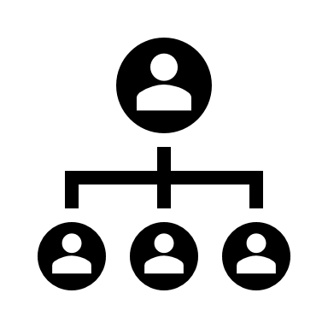
We found it important to think more carefully about our work through:
Our values, beliefs and attitudes
Access and equality
The Social Model of Disability
Representation and leadership
Our working practices and cultures
Creativity

Slide 33


A shift in the balance of power
Working together
Social justice
Bringing about change

Slide 34
Reflection and learning lead to planning and action for real change.
34

Slide 35

What is next?
Questions we need to ask ourselves:
What is missing?
How can you change or provide input so that this is useful to you?
What change will this make?
What will that change look like?

Slide 36


What other questions need to be asked?
Who else needs to be heard?
Please read this document carefully and consider how it makes people feel and reflects their experiences.
It could be recreated or changed over time. Any changes must keep the same values.
36

Slide 37
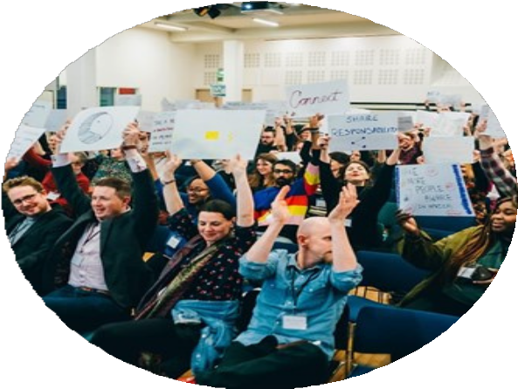
These values are:
Change, Equality, Rights, Creativity, Access and Action.
Making Music is the Key!
37

