Slide 1
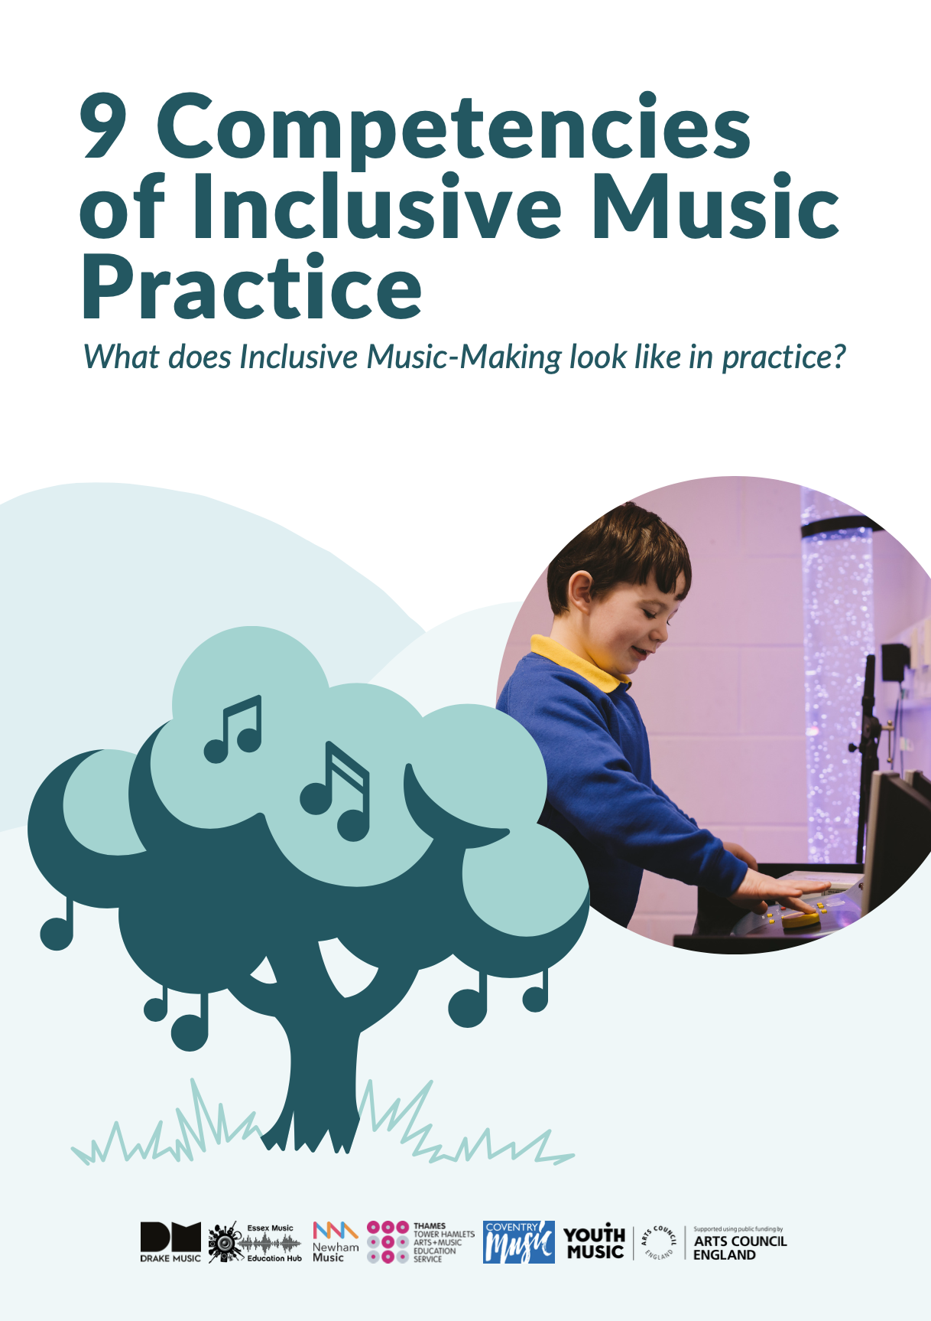
9 Competencies of
Inclusive Music Practice
What does Inclusive music-making look like in practice?

Slide 2





Document guidance
If you have a long document to read, it can be helpful to break it down into smaller pieces.
This will make it easier to focus and take in the information. Here are some tips.
Identify the different sections of the document. You can see the sections of this document on the Contents page.
Focus on reading one section at a time. Once you have finished reading a section, take a break.
Take notes as you read. This will help you to remember the key information and identify any questions you have.

Slide 3

Document guidance
Take breaks or pause. It's important to take breaks when reading a long document, so that you do not get tired or lose focus.
Competencies are the skills and qualities that make someone good at a job.
The following words and phrases in this document are capitalised as they represent a movement or community:
Disabled People
Non- Disabled People
Disability Equality
Inclusion

Slide 4
Contents of the document
In this document you will find: | Introduction
Page number | Section
Page 7 | Introduction
Page 14 | 9 Competencies of Inclusive Music Practice
 | Case Study Summaries:
Page 16 | 1. Underpin all practice with Social Model of Disability
Page 20 | 2. Get to know the learners
Page 24 | 3. Work with other adults to support learners effectively
Page 27 | 4. Respond effectively and incorporate learners' ideas, actions and contributions
Page 30 | 5. Find and use technology that removes barriers
Page 34 | 6. Choose appropriate teaching resources

Slide 5
Contents of the document
In this document you will find: | Introduction
Page number | Section
Page 37 | 7. Structure sessions effectively
Page 42 | 8. Scaffold activities so learners can work together
Page 45 | 9. Create a positive, nurturing environment
 | Case Studies:
Page 49 | 1. Underpin all practice with Social Model by Amy Tolley
Page 52 | 2. Get to know the learners by Hilary Cornell
Page 58 | 3. Work with other adults to support learners effectively by Tim Wall
Page 62 | 4. Respond effectively and incorporate learners' ideas, actions and contributions by George Webb
Page 67 | 5. Find and or use technology that removes barriers by Calina de la Mare

Slide 6
Contents of the document
In this document you will find: | Introduction
Page number | Section
Page 71 | 6. Choose appropriate teaching resources by Steve Barbe
Page 75 | 7. Structure sessions effectively by Calina de la Mare
Page 78 | 8. Scaffold activities so learners can work together by Tim Fletcher
Page 81 | 9. Create a positive, nurturing environment by Annabel Clapham
Page 83 | Background

Slide 7



Introduction
This document is mainly for people who work in music education settings.
They may wish to learn more about inclusive music education and improve their practice.
This document can help with this goal.
It includes 9 competencies with:
Descriptions - ideas on what the 9 competencies mean.

Slide 8



Indicators - pointers on what this may include in practice.
Reflections - invitations to think about how you work and grow in your own practice.
9 case studies are included.
They have been written by music leaders from the Core Hub Partners.
8

Slide 9



The case studies show how the competencies have been applied to their practice.
How did we develop 9 competencies?
The Drake Music team thought about what inclusive practice looks like.
The team then developed a set of competencies that would help music teachers and leaders develop their inclusive practice.
This was at the start of Think22.
9

Slide 10



Think22 was an important programme of work.
This work helped to make inclusive music education more important in England.
We shared these competencies with our:
Music Education Hub partners
Their practitioners
Music leaders
The aim was to get their feedback.
10

Slide 11


We worked together to improve and agree the final competencies.
This became the set of 9 competencies we use today.
We asked some practitioners and music leaders to share real examples of how the competencies are used.
These real examples are called case studies.
The competencies are not finished. They can and should change over time.
11

Slide 12




This is not a complete list of competencies or case studies.
There may be more competencies in the future.
Tell us about your inclusive music practices and any new competencies that you think should be added.
Join our online community of Inclusive Music Teachers and Leaders by clicking here.
Disabled People are underrepresented in our workplace and in our industry.
12

Slide 13

Sharing these competencies will help to make our workplace and industry more inclusive of Disabled People.
13

Slide 14
9 Competencies of
Inclusive Music Practice
Respond
effectively and incorporate
learner ideas, actions and
contributions
Get to know the learners
Create a positive, nurturing
environment
Find and use
music tech that removes barriers
Underpin all
practice with the Social Model
Work with other adults to support learners
effectively
Structure sessions
effectively
Choose
appropriate teaching
resources
Scaffold activities so learners can work together
Page 2 of 38

Slide 15
Case Study
Summaries
Page 3 of 38

Slide 16


Underpin all practice with the Social Model
This means:
Identifying barriers faced by individual Disabled musicians.
Celebrating Disabled and Non-Disabled peers working together.
Advocating and sharing your learning.
Reflecting and making changes.

Slide 17


In practice, this will include:
Checking or reviewing that the space and resources you are using are right for the learner.
Using different communication techniques and styles to support the learner.
Creating an appropriate, welcoming atmosphere with a sense of belonging.
Valuing and supporting learners' access needs so that they can participate fully.
17

Slide 18


Giving choices to ensure the power shifts to the learner.
Making sure support is in place to encourage learning.
Celebrating difference and diversity in the session.
Identifying opportunities for creativity and progression and raising expectations of what is possible.
Exploring your own attitudes, language and assumptions before the session.
18

Slide 19


Click on the link to read the case study "Underpin all practice with the Social Model" by Amy Tolley here.
This case study will talk about how these indicators are used in real life.
Reflect:
What signs can you identify in your own practice?
Reflect:
What are your own
attitudes, assumptions and expectations
towards disability and Disabled People?
How might these appear in your practice?
Explore:
Watch this introduction to the Social Model of
Disability. Discuss with
your team how you might apply some of the questions raised in your sessions with your learners.
19

Slide 20



Get to know the learners
This means:
Getting to know what works for each learner and what supports them to achieve their best.
Building flexible session plans.
Noticing and building upon what works.
Recognising the whole person and the wider picture.

Slide 21


In practice, this will include:
Understanding your learners' needs and what motivates them to help them fully participate.
Noticing and amplifying the quietest voices.
Understanding how different learners communicate and what works best is important.
For example, for learners who are non-verbal or partially speaking.

Slide 22



Building the right support for the session.
This could include working with Special Educational Needs Coordinators (SENCO) and classroom teachers.
This work would happen before and after sessions.
The aim would be to:
Clarify roles,
Assess the space for learners,
Question assumptions
Reflect on the dynamics in the session

Slide 23

Reflecting and making notes on what works or can be developed.
To see these indicators in action, read the case study “Get to know the learners” by Hilary Cornell here.
Explore:
The iPad is a very useful instrument, with
opportunities to make
music at different levels of complexity. Explore the
iPads f or Music step-by- step guides to get you
started making music with iPads.
Reflect:
What can you identify in your
own practice that is relevant to this
competency?
23

Slide 24
Work with other adults to support learners effectively
This means:
Building effective support for the session and making sure that roles and expectations are clear.
Being clear about your own approach to teaching and classroom management.
Sharing your approach and goals with school staff if possible.

Slide 25





In practice, it means:
Working with other school staff to support learners effectively.
Being clear about your own teaching approach and goals and sharing them with others.
Creating a welcoming and responsive learning environment.
Allowing learners to learn at their own pace.

Slide 26

You should be prepared to provide one-to-one or small group support when needed.
To see these indicators in practice, read the case study “Work with other adults to support pupils effectively” by Tim Wall here.
Reflect:
What can you identify in your
own practice that is relevant to this competency?
Explore:
Do, Review, Improve... A quality framework to help practitioners working with Disabled young people. This is by providing information to remove barriers and showing good practice.
Reflect:
How can you show your colleagues in the room how to support and empower students?
26

Slide 27




Respond effectively and incorporate learner ideas, actions and contributions
This means:
Being flexible in your approach.
Making space for young people's ideas and contributions.
Changing the course of your planned delivery based on learner ideas and contributions.

Slide 28

In practice, it means:
Be flexible in your approach and be willing to change your plans based on what the learners are interested in.
Make sure that the learners feel heard and that their ideas are valued.
Encourage the learners to be creative and to share their work with the group.
Give the learners opportunities to lead and to learn from each other.

Slide 29
To see these indicators in practice, read the case study "Respond effectively and incorporate pupil ideas, actions and contributions“.
This is by George Webb and can be found here.
Reflect:
Think about each student's strengths and talents. How can you use them in your lesson plans and teaching?
Reflect:
What can you identify in your own practice that is related to this competency?
29

Slide 30



Find and use music technology that removes barriers
This means using technology to make it easier for Disabled People to play music.
This can include:
Using alternative instruments.
Making low-tech adaptations to instruments.
Using adaptive accessories.

Slide 31


In practice, this means:
Focusing on and working with the needs of the learner.
Exploring and trying different things out to find what works best.
Looking at how others have used or modified technology. This can include observing Disabled artists who are using technology.
On the next page are some examples of technology that can be used to remove barriers for Disabled musicians.

Slide 32






Thumb Jam (iPad)
Garage Band (iPad)
Keezy (iPad)
Tobii and Clarion
Microphones
FX pedals
Gaming switches
Audio recording software

Slide 33
To see these indicators in practice, read the case study "Find/ use tech to remove barriers" by Calina de la Mare here.
Reflect:
What indicators can you identify in your own practice?
Reflect:
Consider how iPad apps can be part of and expand the range of instruments in your toolkit.
Explore:
The iPad is a very useful instrument, with opportunities to make music at different levels of complexity. Explore the iPads for Music step-by-step guides to get you started making music with iPads.
33

Slide 34

Choose appropriate teaching resources
This means:
Knowing what resources are available.
Knowing how to use these resources to meet the needs of all learners.
Being creative and being able to adapt. Creating a learning environment that is engaging and inclusive.

Slide 35

In practice, it means:
Modifying and adapting resources to meet the needs of all learners.
Choosing resources that are appropriate for different learning styles.
Choosing resources that are engaging and interesting to learners.
Creating a learning environment that is inclusive and welcoming to all learners.

Slide 36
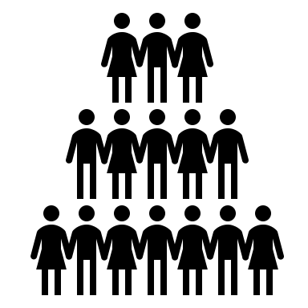
It is also important to choose resources that are inclusive and that reflect the diversity of your learners.
This means choosing resources that represent different cultures, ethnicities, and abilities.
To see these indicators in practice, read the case study "Choose appropriate teaching resources" by Steve Barbe here.
Reflect:
What can you identify in your own practice that is relevant to this competency?
Reflect:
Consider with the team the teaching resources in your 'collective toolbox'. Make a list of these and how they might work with your learners. Share them with your team so that if anyone is away, they are still in the 'collective toolbox'.

Slide 37
Structure sessions effectively
This means:
Providing a space for all learners to participate and contribute.
Designing activities that are appropriate for their attention spans, abilities and preferences.
It also means clearly communicating the structure of the session and being flexible enough to adapt it as needed.
For example, you could do this by using PECS® (Picture Exchange Communication System).

Slide 38
In practice, it means:
Checking access and support requirements before the session starts.
Identifying the learners' current and future goals.
Structuring the session to include a variety of activities, such as the following examples on the next page.
38

Slide 39


Team briefing
Soft start
Introducing and discussing the session plan
Breaks
Group work
Feedback
A team debrief

Slide 40

Being aware of all the learners in the room, including those who are quieter.
Being willing to change the structure of the session if needed.
Encouraging feedback from the learners and using it to improve future sessions.
Using a variety of communication skills to support all learners, including those with nonverbal communication needs.
To see these indicators in practice, read the case study "Structure sessions effectively" by Calina de la Mare here.

Slide 41
Reflect:
Talk to your team about which students are quietest or contribute the least. Think about what might be stopping them from participating. What can we do to help them? Involve students in this conversation if we can without making them feel uncomfortable.
41

Slide 42
Scaffold activities so learners can work together
This means:
Giving learners different ways to contribute to the same activity.
Making space for different types of work, such as individual, pair and small group work.
Making space for improvisation and free play.
There not being a "right way" to do or play something.

Slide 43


In practice, it means:
Creating opportunities for learners to receive and give feedback.
Giving learners space to grow and learn.
Recognising learner successes, whether big of small.
Celebrating every contribution and achievement.

Slide 44
To see these indicators in practice, read the case study “Scaffold activities so learners can work together” by Tim Fletcher here.
Reflect:
Think about what you expect in teaching, music-making, or other life experiences. Think about mistakes, chances, and new ways of doing things that have helped you learn and grow.
Explore:
What is Inclusion? Making Music is the Key
44

Slide 45


Create a positive nurturing environment
This means:
Make everyone feel welcome and respected.
Be a good role model.
Think about your own pace, space and tone. Ensure people are working with you.
Help everyone to understand and appreciate each other.

Slide 46


In practice, it means:
Creating a sense of belonging.
Helping everyone to understand each other and to celebrate diversity.
Celebrating the achievements of everyone in the group.
To see these indicators in practice, read the case study Create a positive, nurturing environment by Annabel Clapham here.

Slide 47
Reflect:
Consider how you can work with learners to set ground rules and value everyone's voices.
Explore:
What is Inclusion? Making Music is the Key
47

Slide 48
Case Studies
Music leaders from three different music education hubs participated in a programme to learn how to include inclusive practice in their work.
The hubs were Essex Music Education Hub, Newham Music, and THAMES (Tower Hamlets Arts and Music Education Service).
The case studies they wrote illustrate how they applied the competencies they learned to their practice.
Page 3 of 38

Slide 49



Underpin all practice with the Social Model by Amy Tolley, Essex Music Education Hub
I am a music teacher for a 13-year-old boy called R who has complex needs. He has been taking piano lessons with me for six years in a special education school setting.
I make sure that the room is safe and comfortable for him. I also make sure that R has a routine and that I know what his interests are.
We communicate through music. We play the piano, sing, and listen to recorded music. R has learned a lot about music from me.
Page 3 of 38

Slide 50


Underpin all practice with the Social Model by Amy Tolley, Essex Music Education Hub
R has also performed in front of his class and the whole school. He played piano in a performance of The Lion King, and he has participated in talent shows and assemblies.
My teaching practice is learner-led and flexible. I make notes after each lesson so that I can improve my teaching.
I also make sure that the lessons are relevant to R and that they support his musical development.
I am proud of his progress, and I am committed to helping him reach his full musical potential.
Page 3 of 38

Slide 51
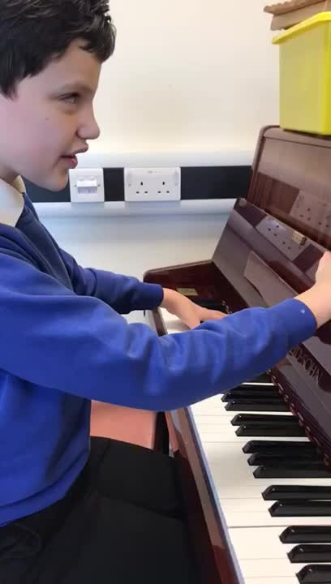
Watch R's 100 piano songs performance here.
“It is important that we share the same language. Over time, I have worked with him and seen his music knowledge and understanding grow through our shared language of music.”
Page 3 of 38

Slide 52


Get to know the learners by Hilary Cornell
I am a music teacher and I started working with a 10-year-old student named C in one-to-one music sessions. C was part of a group of four students that each had high support needs.
The Special Education Needs Coordinator (SENCO) gave me some information about the pupils. This was to support my understanding about each individual pupil.
At first, C was shy and not keen to participate. But I was patient and supportive, and she slowly began to trust me.
I used a variety of musical instruments and activities in the sessions. This included the guitar, ukulele, drums, vocals, and apps like GarageBand and ThumbJam.
Page 3 of 38

Slide 53

Get to know the learners by Hilary Cornell
I planned the sessions in small sections, with time to reflect and discuss what we liked or disliked. This allowed me to take note of C's progress, engagement, and “WOW” moments.
C's sessions were shorter and involved encouraging her to enter the music room with a positive feeling towards music.
At first, her sessions were about engaging her in music and increasing her resilience to music lessons each week.
C quickly began to show trust in me, knowing that I would not force her to continue if she was distressed. I also allowed her to indicate when she would like to finish and ended each session with a goodbye song.
Page 3 of 38

Slide 54

Get to know the learners by Hilary Cornell
I noticed that C enjoyed listening to me playing the piano the most. We continued this for a few weeks, increasing the length of time I played and the session time each time.
I also very slowly began to increase the volume of the piano, observing her response.
C's support worker noticed that C's resilience had improved a lot in sessions. This also happened at school and at home. She had accepted music being played in the car, and at times in class.
Her support worker started singing instructions everyday, which was a great success. C's parent has explained that her sister can now sing at home again.
Page 3 of 38

Slide 55

Get to know the learners by Hilary Cornell
I found a keyboard for C to take home and bring back each week. This made her own music hers and let her play it at home whenever she wanted.
I also used C's love of pets to encourage her to make sounds and groups of notes that sounded like different animals.
When the sessions came to an end, C's mum signed her up for paid sessions with me. These sessions have been a total success. C is now reluctant to leave music at the end of our lessons and asks questions about different instruments.
She now shows very little noise avoidance at school and at home and thoroughly enjoys music.
Page 3 of 38

Slide 56
Get to know the learners by Hilary Cornell
Overall, the music sessions helped all the learners to build confidence, resilience, and companionship. The learners have also grown the ability to create music together.
They have grown these skills together and this can be seen in the sessions, at home and at school. The sessions have also helped the learners to develop music skills that they may not have realised they had.
Page 3 of 38

Slide 57
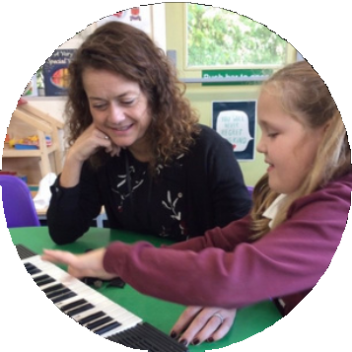
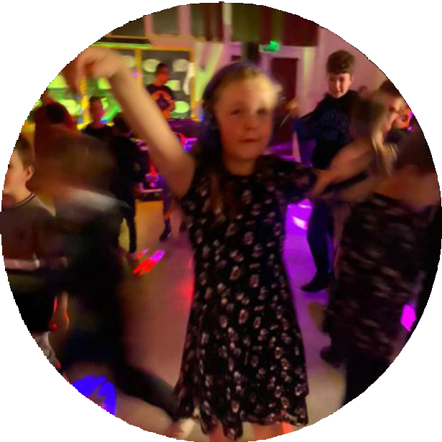
“I noticed that C was interested in the piano, so I found her a keyboard to take home and bring back each week. This way, she could practise music at home in her own time and space.”
“C having fun at the school disco surrounded by music and noise. She would never have stepped near the building let alone inside to attend this pre music sessions.”
C's parent
Page 3 of 38

Slide 58
Work with other adults to support learners effectively by Tim Wall
I am a music teacher and I lead group sessions for 3-4 Disabled learners in a mainstream primary school. I create a welcoming environment for the children to explore and interact with at their own pace.
I set up a variety of instruments and sensory items on the floor and play music in the background. I introduce more structured music-making as the children become more familiar and comfortable with the sessions.
It can be challenging to support multiple children at once, especially if they have different needs or interests. I try to engage the support staff in the room to help support the children.
Page 3 of 38

Slide 59



Work with other adults to support learners effectively by Tim Wall
I advise the support staff before the session. However, I often find that they have different expectations about how the children should behave in the session. They may try to get involved and direct the children.
When I see this happening, I usually say something to the adult such as "It's okay if they hold the ukulele like that" or "It's fine if they don't want to play anything."
I also find it effective to ask the adults not to speak. This usually forces them to find new and musical ways of interacting with the children.
Another effective approach is to simply hand the support staff an instrument of their own. This focuses the staff not on controlling a child but on adding to the music.
Page 3 of 38

Slide 60


Work with other adults to support learners effectively by Tim Wall
This can be a challenge. This is because the support staff often change. Sometimes there is not always the opportunity to advise them before or give them tips during the session.
Some staff adapt to the sessions very quickly. Some staff find it difficult to understand how to interact, even with my encouragements or explanations.
To overcome this challenge, I am working on setting up a training session for the support staff. I will run some musical activities with them and explain the reason behind what we are doing.
I hope that this will help me to set up a more consistent way of working with the adults to support the children in my sessions.
Page 3 of 38

Slide 61
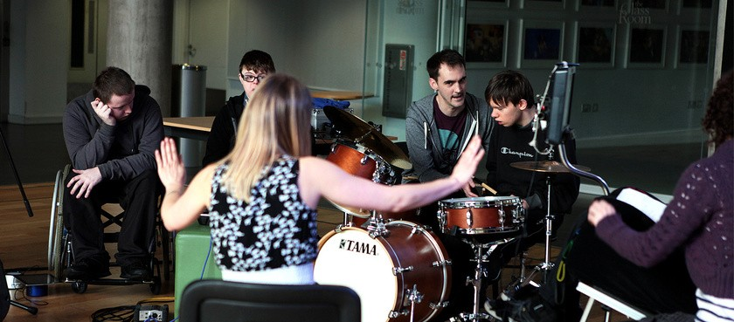
"My approach is to create a welcoming and responsive
musical environment for the children to explore and interact with at their own pace."
Page 3 of 38

Slide 62

Respond effectively and incorporate learner ideas, actions and contributions by George Webb
I am a music teacher and I have been working with two students, N and J, in a small group setting. N and J are both high energy, active students with additional support needs.
In the sessions, we improvise with iPad apps and compose music using different software. N and J have many ideas and like to change direction quickly. They also express themselves loudly.
To keep N and J engaged, I structure the session with several short activities:
Warm-up
Main activity
Re-focusing song/activity
Main activity
Goodbye song
Page 3 of 38

Slide 63


Respond effectively and incorporate learner ideas, actions and contributions by George Webb
I also try to be flexible and incorporate their suggestions.
N and J are now familiar with how the session is set out and remind me if I miss a section. This has helped with their progression.
Both students are very excited when entering the music room and look forward to the Hello Song. They sing and clap along and offer suggestions for who to say hello to.
I encourage N to include the items he picks up in the room into the Hello Song, which he enjoys. I also encourage J to express himself through dance during the Hello Song.
The main activity of the sessions is creating an original composition using smart instruments, voice and piano. N and J have named the composition “Sonic” as the music represents Sonic the Hedgehog.
Page 3 of 38

Slide 64


Respond effectively and incorporate learner ideas, actions and contributions by George Webb
N and J are very keen to try out all the smart instruments in GarageBand. To manage this choosing section, I ask N and J to think about the sound of each instrument before this can develop into fast scrolling on the iPad.
Once N or J select a smart instrument, I encourage them to play for the other and decide if they both like the sounds, if they can adapt or experiment with the sounds within the settings, and if they are going to use the instrument within the composition.
This has helped slow the pace of choosing a virtual instrument and encouraged them to think ahead to the overall arrangement of the composition.
N and J have also recorded voice parts to the composition. They enjoyed listening back to their voices and experimenting with effects to change the sounds.
Page 3 of 38

Slide 65


Respond effectively and incorporate learner ideas, actions and contributions by George Webb
At times, the recording of the voice parts proved challenging as they would get excited and talk over each other's part.
I responded to this issue by giving the responsibility of recording (counting the other in and pressing record and stop) to the non-recording student. This has helped to keep them focused and engaged in the activity.
By structuring the sessions with several short activities, and also being flexible to include N and J's ideas, behaviours, and energy, I feel that these sessions have been successful for their learning.
This is reflected in their excitement to attend the sessions and how proud they are to share the content of their work.
Page 3 of 38

Slide 66
"N loves going to his music lessons, he is always excited to share what he has been learning and this earned him a gold award in assembly."
N's class teacher
Page 3 of 38

Slide 67

Find/use music tech that removes barriers by Calina de la Mare
This case study is about an all-ability inclusive music collective called Soundbox. It brings together Disabled and Non-Disabled musicians aged 11-25. Soundbox uses technology to remove barriers to playing music.
We use iPads and backline (e.g., microphones and amplifiers) to create music.
iPads are ideal for inclusive settings because there are many different software programs and apps that can be used. The iPads can be connected to portable Bluetooth speakers such as Minirigs.
There are some of the accessible apps that Soundbox uses on the next page.
Page 3 of 38

Slide 68



Find/use music tech that removes barriers by Calina de la Mare
ThumbJam: It has 40 instrument samples with many scales to play in any musical style. The user uses their finger to slide across or tap the screen to make sounds.
GarageBand: You can record synth or real time sounds and then play them back or alter the sound using FX (special effects).
Keezy: The screen consists of eight coloured rectangles, each representing a different sound. There are pre-set sounds, or you can record your own.
Soundbox also uses eye and body tracking technology. For example, Soundbox participant J uses Eyeharp with an external speaker, using different sounds for sections of the music.
Page 3 of 38

Slide 69


Find/use music tech that removes barriers by Calina de la Mare
Soundbox also uses microphones and FX pedals to encourage sound making and the creation of different sounds.
For example, participant A uses the mic with acoustic guitar and participant J enjoyed using the delay pedal with voice.
Soundbox also uses gaming switches to trigger samples by connecting them to software.
For example, they used these for a concert. They assigned samples to two switches and participants triggered them.
Page 3 of 38

Slide 70

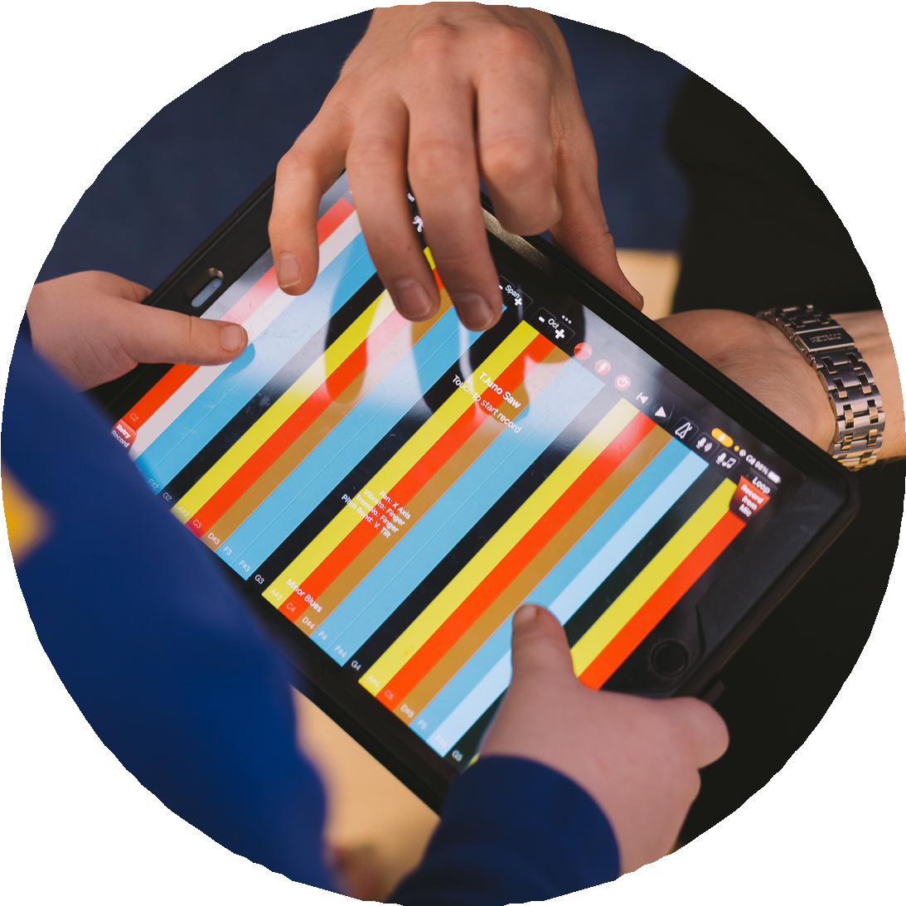
Find/use music tech that removes barriers by Calina de la Mare
Finally, Soundbox uses audio recording software to record the sounds they make in their sessions and listen back in the next session. This is so they can then work on the music further.
Overall, Soundbox is a great example of how technology can be used to make music more accessible to everyone.
“I don’t need easy.
I just need possible.”
- Bethany Hamilton, Disabled athlete
Page 3 of 38

Slide 71


Choose appropriate teaching resources by Steve Barbe
I am a music teacher and I work with small groups of children with additional learning needs.
I use a structured approach called "Box Time”. This is based on an activity called ”Bucket Time”. During the activity I bring out objects from a box one at a time and we do activities with them. This helps the children to focus and stay engaged.
My music sessions follow a similar structure each time:
Hello song
Song "What is in the box today?"
Activities with the objects in the box
Goodbye song
Music time finished
Page 3 of 38

Slide 72



Choose appropriate teaching resources by Steve Barbe
I use a variety of objects in the box, such as toy characters, props, instruments and iPads. I choose songs and activities that are right for the objects. For example, if we have a rabbit in the box, we might sing "Sleepy Bunnies."
I use Makaton signs to help the children understand and participate in the activities. For example, when we finish with an object, I say the object's name and make the Makaton sign for "finished."
I think it's important to have a consistent structure for my music sessions. This helps the children to know what to expect and makes it easier for them to participate.
Recently, I had a child in my group who was very excited from the start. The staff members present asked me to stop an activity because they thought it was too triggering for the child.
Page 3 of 38

Slide 73

Choose appropriate teaching resources by Steve Barbe
The staff then asked me to stop the next activity called the “brolly activity”. This was due to the same reason. The child was becoming very excited. I was frustrated because I was running out of planned activities.
I met with the staff members later that day and we talked about the situation. They said that they were playing things by ear and that they found it very exhausting.
We agreed that I could try my activities again in the future, but that I would always have spare activities on hand. These spare activities should include some that are less triggering for the child.
I think the learning point here is to always have spare material on hand, including material that is more calming and less stimulating if needed.
Page 3 of 38

Slide 74
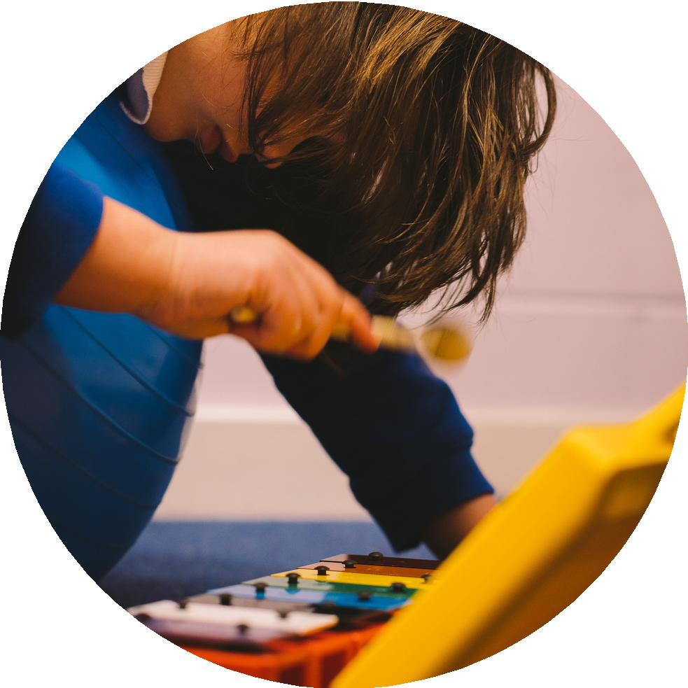
"Always having spare material to hand is the learning point here I
feel, including material that is more calming
and less stimulating if needed."
Page 3 of 38

Slide 75

Structure sessions effectively by Calina de la Mare
Soundbox is an inclusive music collective in East London that brings together Disabled and Non-Disabled musicians aged 11-25.
These are some examples:
Planning
Find out about the participants, such as if loud sounds are intense for them.
Make sure the space is accessible.
Have a selection of musical instruments and technology available.
Theme
Choose a theme for the term, such as "Listening."
Listen to a different composer each week or listen to each other's music or recordings of music already created.
Page 3 of 38

Slide 76

Structure sessions effectively by Calina de la Mare
Structuring content and timings
Start with a soft start song to allow people to arrive, choose instruments, and get settled.
Briefly introduce the session plan.
Listen to sounds recorded in the previous session.
Respond to the sounds.
Take a break.
Break out into smaller groups to share musical ideas.
Have a participant share their favorite piece of music to play or dance to.
Get feedback from the participants.
Signposting
Write the structure of the session on the board using words, colours and pictures.
Page 3 of 38

Slide 77
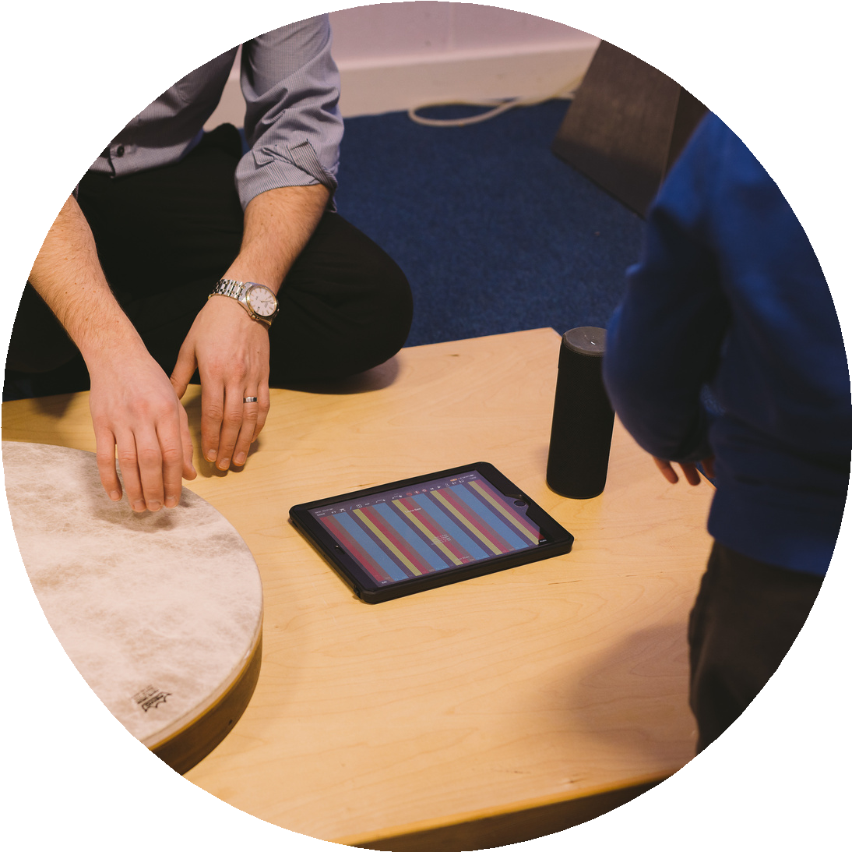
Structure sessions effectively by Calina de la Mare
Feedback
Ask the participants for a word or sound that communicates their experience from the music-making that day.
Have the participants answer a simple question, such as "What was your best musical moment of the morning?"
Have the participants write down or draw a thought or emoji.
Support for non-verbal participants
Use thumbs up/down and Makaton signs.
Solo/record sounds in Keezy.
"The participant can answer a simple question: what was your best musical
moment of the morning?"
Page 3 of 38

Slide 78
Scaffold activities so learners can work together by Tim Fletcher
I work with groups of learners aged between 8 and 10 in a mainstream school. I encourage them to be musically creative, but it can be difficult, especially for those with limited technical skills.
In the past, I have had some success with simple improvisation, but it's often messy and lacking in focus.
Last term, I ran a 'music nurture group' at a primary school. I tried different activities, including improvisation in response to my playing. I also used the piano to encourage experimenting, but it seemed aimless at times.
I wanted to encourage the learners to be more thoughtful about what they were creating and promote some thinking about the purpose and context.
Page 3 of 38

Slide 79




Scaffold activities so learners can work together by Tim Fletcher
I was interested in the idea of learners developing their own motifs to portray a character in a film. I played some examples, including the two-note motif for the shark in 'Jaws'.
The children seemed to know it, so I decided to use the children's story 'The Three Billy Goats Gruff'. The 'baddie' (the troll) could have a menacing motif, and the three goats could have three similar but distinct motifs.
One group of three students created the motifs on the piano. The other three students explored the use of percussion instruments as sound effects. To perform the piece, the students had to follow the story and play their motifs and sound effects at the correct time.
This was successful. The learners had the opportunity to choose their own way of using the instruments, especially the percussion instruments, which were used in imaginative ways.
Page 3 of 38

Slide 80


Scaffold activities so learners can work together by Tim Fletcher
The more structured approach to creativity was a good idea, as the learners could easily relate to the story and understand what they needed to do.
The creative part was open-ended enough to enable them to do so with relatively little guidance from me or the other staff. The learners enjoyed the process and requested to do it again the following week.
I think this approach is a great way to encourage young people to be musically creative, even if they have limited technical skills. It's also a fun and engaging way to learn about musical concepts such as motifs, themes and structure.
Listen to 'The Three Billy Goats Gruff' performance here.
"The more structured approach to creativity was a good idea, as the learners could easily relate to the story and understand what they needed to do."
Page 3 of 38

Slide 81
Create a positive, nurturing environment by Annabel Clapham
I taught music classes at a special education school for students aged 7-11. The students had a variety of needs and abilities. I wanted to create an environment where all students felt included, valued and nurtured.
I knew that some students might find it difficult to play traditional instruments. I brought my own keyboard and focused on using nursery rhymes and tunes that the students would know. I also used Makaton signs.
In my first session, I struggled to hold the students' attention. In the next sessions, I decided to sit on the floor with them, cross-legged, with my keyboard in front of me. I thought this would help me to engage with them better.
Overall, the students responded well to this approach. It created a positive and nurturing environment where most students felt comfortable being creative. One student who I was told probably wouldn't engage, even participated in the sessions.
Page 3 of 38

Slide 82

Create a positive, nurturing environment by Annabel Clapham
The only negative was that the keyboard itself became a distraction for some students.
I ended up incorporating this into the sessions by setting aside time at the end of each session for students to play or improvise along with some chords I was playing.
"... something softer, more collaborative, more focused on
them and their musical journey
rather than a specific outcome."
Page 3 of 38

Slide 83

Background
Think22 and an earlier project called Think2020 are important programmes of work funded by Youth Music.
These programmes of work helped to bring inclusive practice into music education in England.
The programmes focused on:
Advocacy, campaigning for inclusive practice and addressing underrepresentation of Disabled People.
Workforce development.
The delivery of inclusive music sessions in schools and other learning settings for children and young people.

Slide 84
This document is one of four resources. These four resources have been developed as part of the Think22 programme.
We have been working with four partners:
Essex Music Education Hub
Newham Music
THAMES ( Tower Hamlets Arts and Music Education Service)
Coventry Music
These resources are an example of Drake Music’s main approach where different people work together.
84

Slide 85
This includes:
Disabled and Non-Disabled educators
Musicians
Leaders
Artists
Practitioners
There is a need for more Disabled leaders, musicians and educators in music education.
Think22 and Think2020 understands that we are working in an environment where Disabled People are underrepresented.
Due to this underrepresentation, there needs to be action to bring about positive change.
85

Slide 86
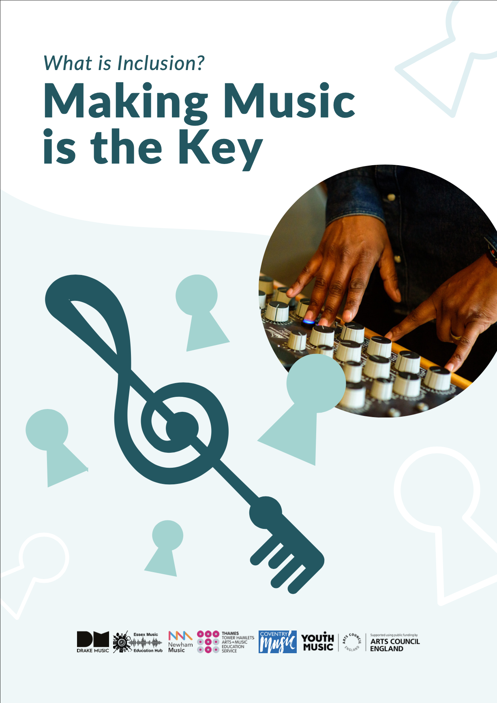
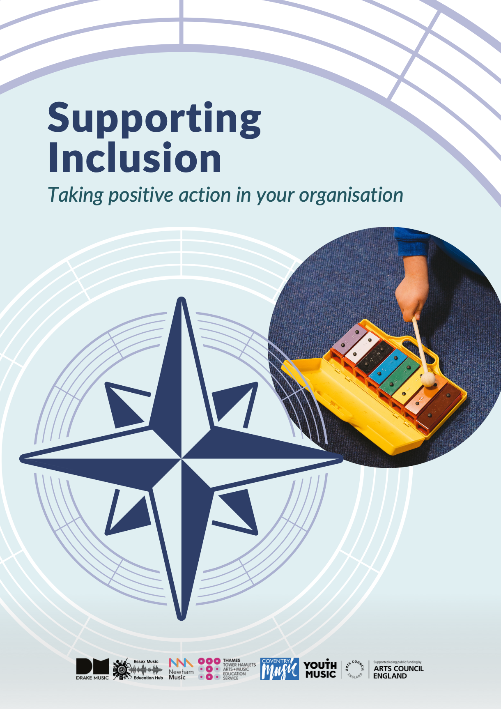
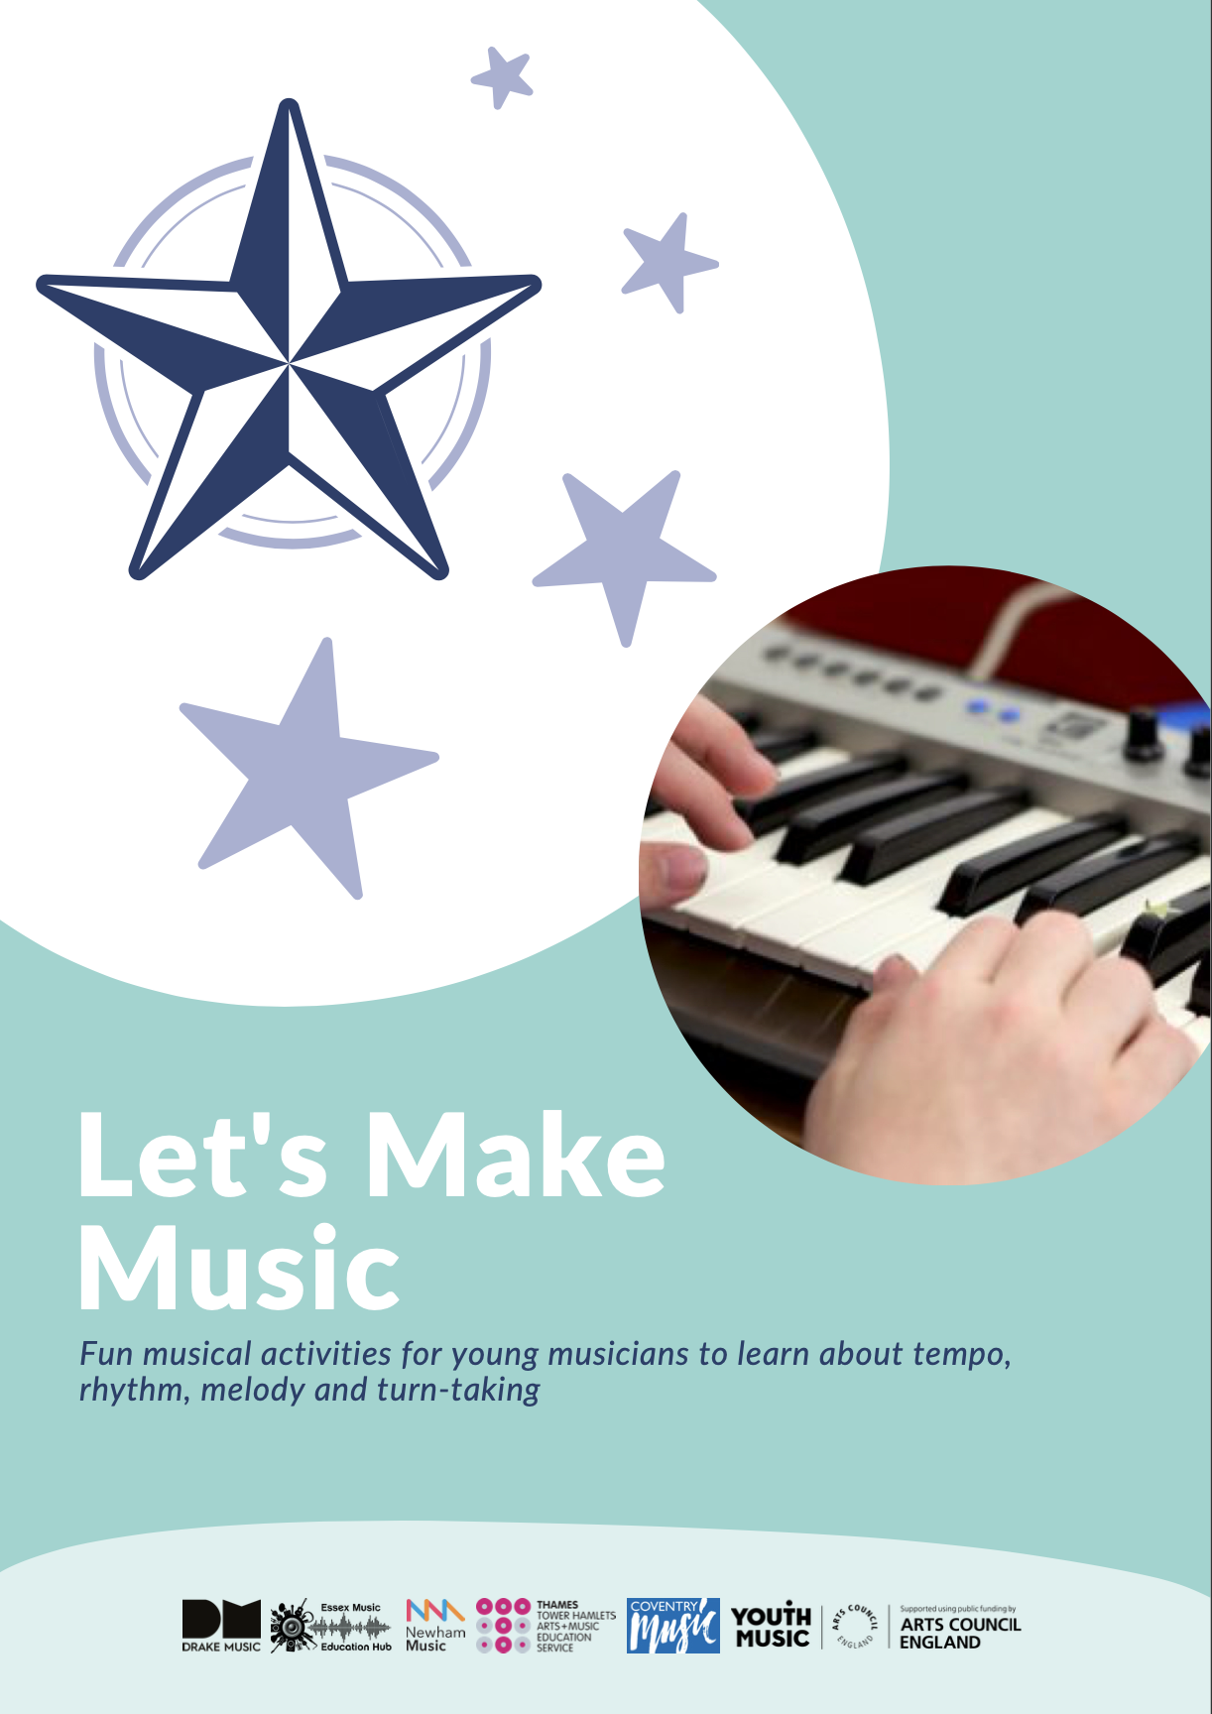
Think 22 resources to read:
What is Inclusion? Making Music is the Key.
Supporting Inclusion - Taking positive action in your organisation.
9 Competencies of Inclusive Music Practice - What does Inclusive Music-Making look like in Practice? (this document).
Let’s Make Music - Fun musical activities for young musicians to learn about tempo, rhythm, melody and turn- taking.
86

